Slide 1
Running rfeAppBasicExample ( The ‘Hello World!!’ of STRX )
rfeAppBasicExample is an application that talks to the rfeFw via the Abstract Driver API. It is a kind of minimal application. It Initialises the rfeFw, loads a minimal configuration and starts a few chirps.
After that it checks for errors. If it succeeds it means the App can communicate correctly with the rfeFw.
Needed:
STRX PCB (which version?)
Lauterbach (which version?)
12 volt power supply for the STRX PCB
S32 Design Studio for S32 Platform Version: 3.4
TRACE32 sw for Lauterbach
rfeFw release (which one?)

Slide 2
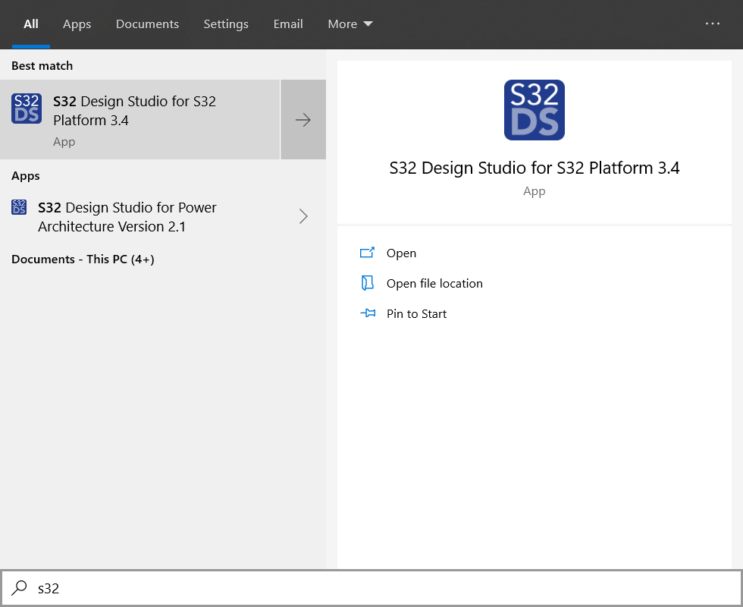
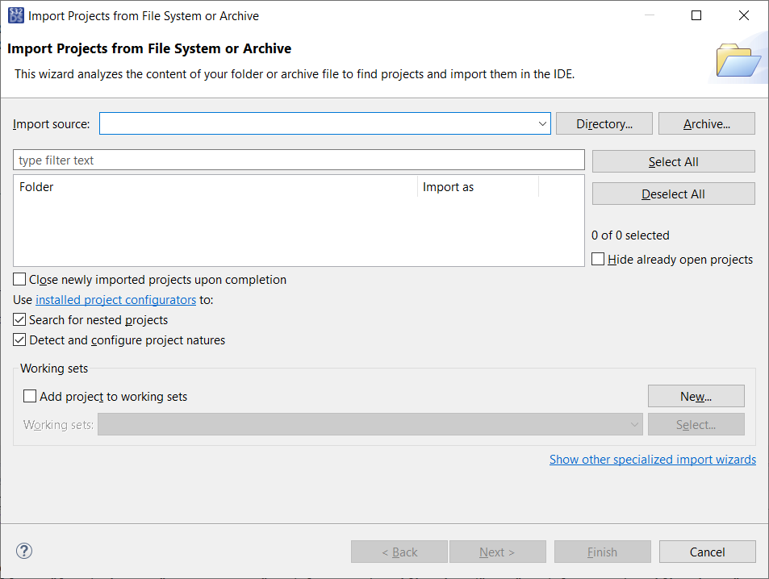
Import rfeAppBasicExample32 as S32DS project
Start S32DS
File -> Open Project from File System

Slide 3
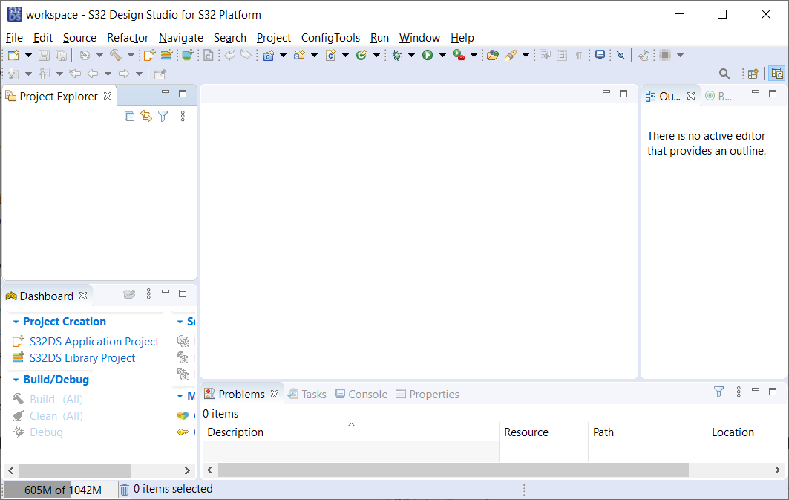
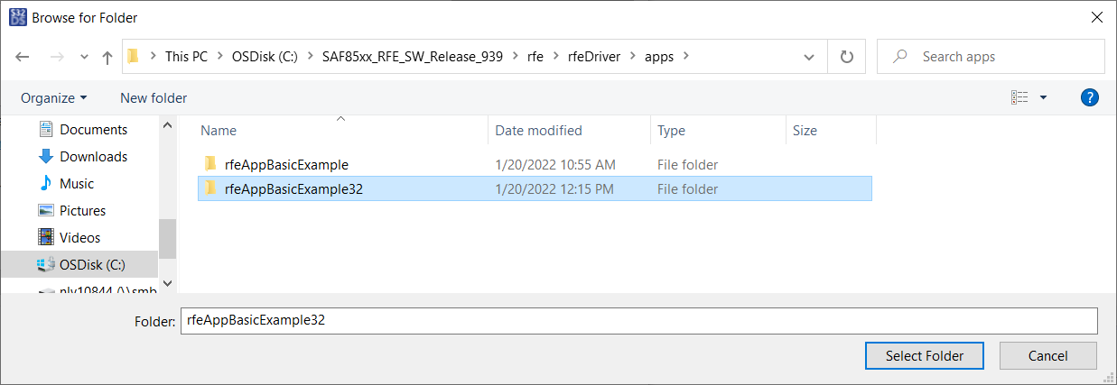
Directory -> C:\SAF85xx_RFE_SW_Release_xxx\rfe\rfeDriver\apps\rfeBasicExample32 (this folder is in the repostry but not yet copied into the release!!)

Slide 4
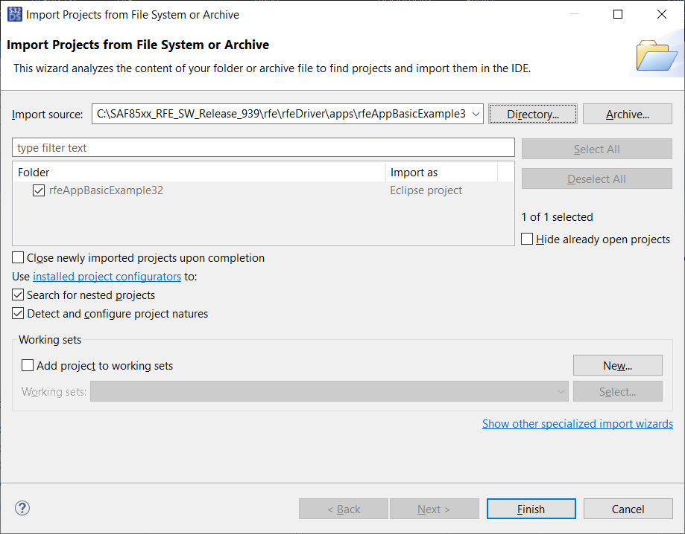
-> Finish

Slide 5
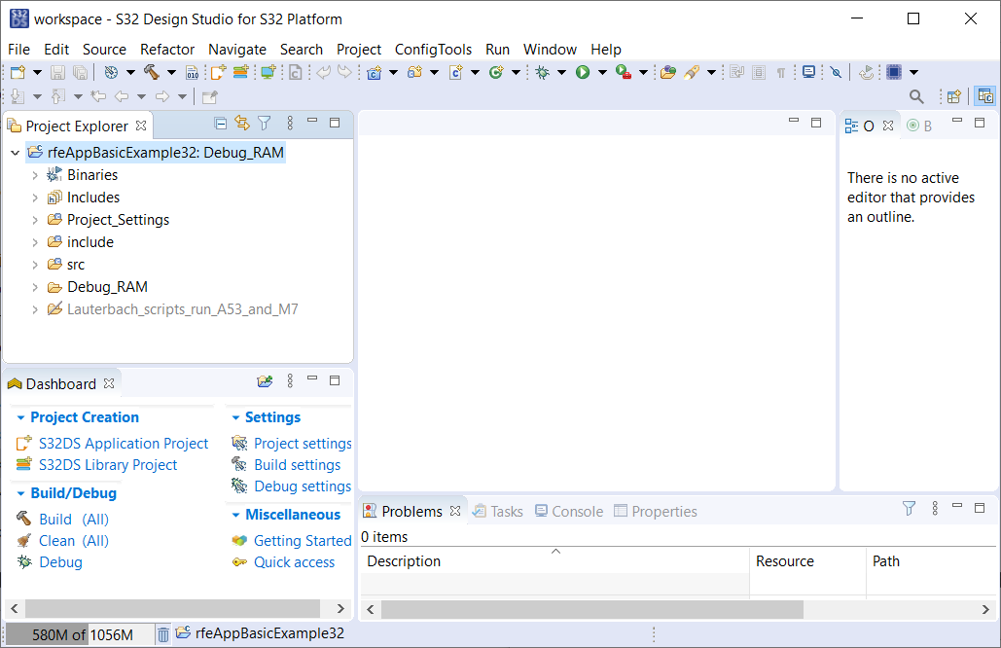
Project imported

Slide 6
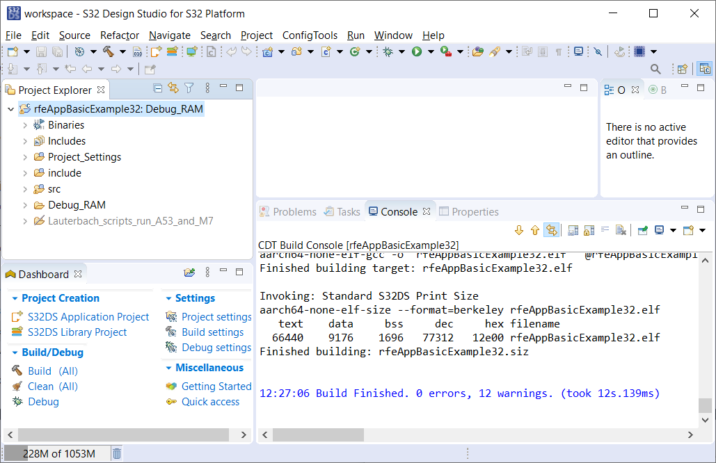
BUILD: Click right on rfeAppBAsicExample32 in the Project Explorer and select “Build” now the .elf file is build

Slide 7
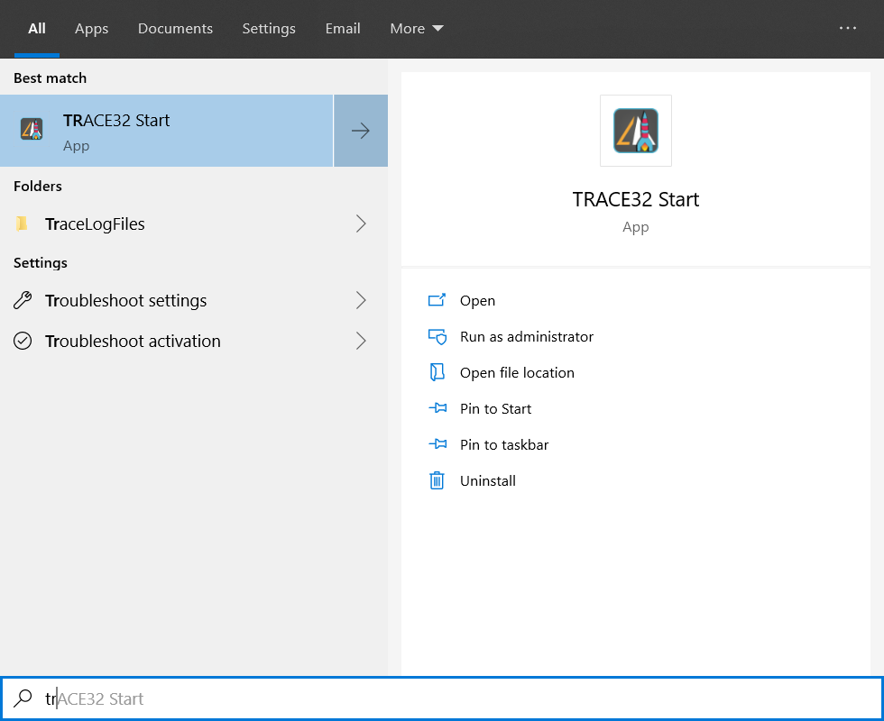
Start debugging session

Slide 8
Multi core debugging
File -> run script Select C:\SAF85xx_RFE_SW_Release_xxx\rfe\rfeDriver\apps\rfeAppBasicExample32\Lauterbach_scripts_run_A53_and_M7
This will open two T32 windows:
1: for the M7 where the rfeFw will run
2: for the A53 where the rfeAppBasicExample32 will run
M7
in the M7 window the rfeFw "rfeFw_hw101_release_armclang.elf" [update?] in this current folder is loaded -> press Go to start this Fw
Data.Load.ELF rfeFw_hw101_release_armclang.elf /MACRO /StripPART 1 /PATH "Z:\"
A53
in the A53 window run script "STRX_A53_load_ELF.cmm“ (todo add breakpoints.cmm)
this will load "../Debug_RAM/rfeAppBasicExample32.elf"
press Go to start (or step if you want to debug) (2 break points are already set to stop at “success” or “failure” [ TODO in the release!])
Data.Load.Elf ../Debug_RAM/rfeAppBasicExample32.elf /MACRO /StripPART 1 /PATH "Z:\" // Open with dialog

Slide 9
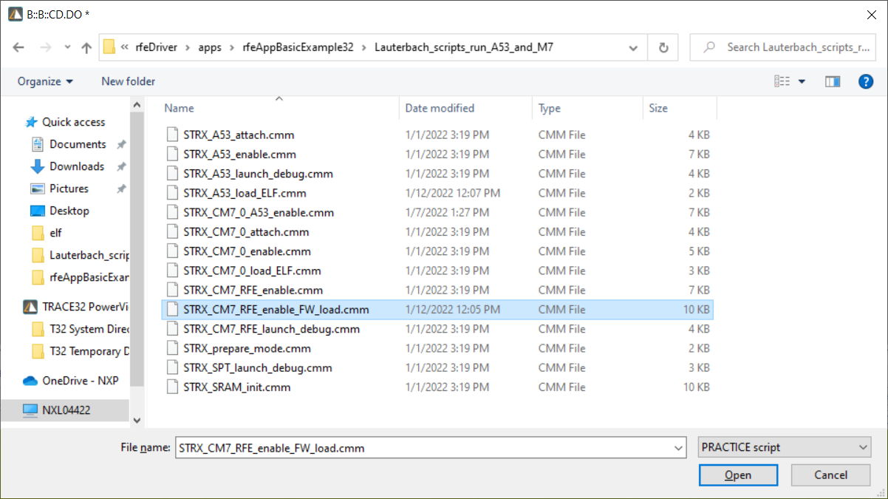
Run
File -> Run script

Slide 10
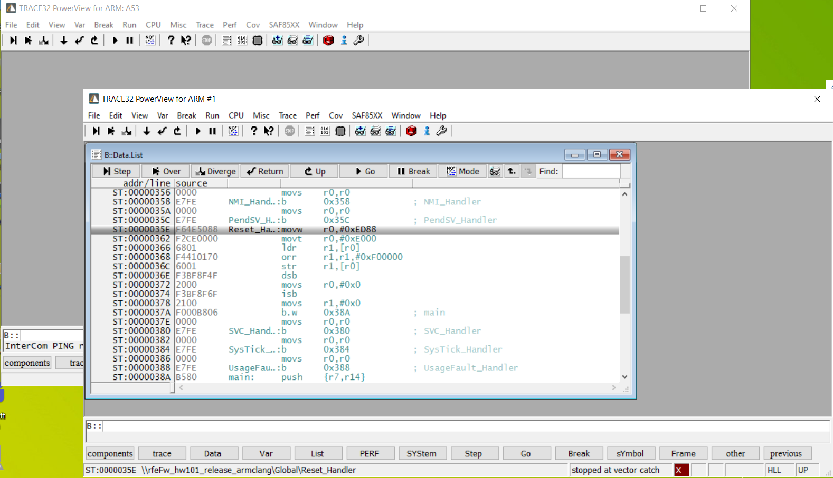
Press “Go”in the ARM #1 window

Slide 11
A53 window: File-> Run script select STRX_A53_load_ELF.cmm

Slide 12
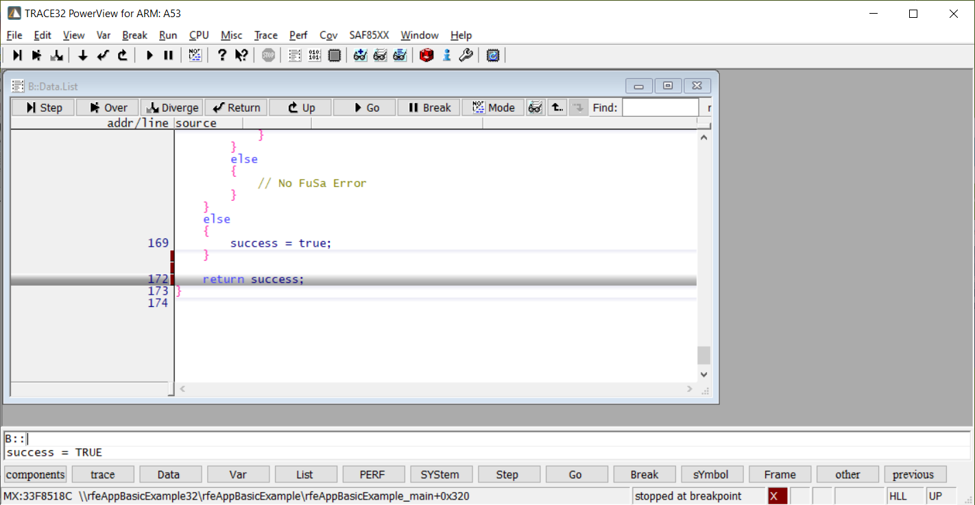
Press “Go” in the A53 window

